Slide 1


Research Reactor Training for
Novice Scientists and Engineers
S. Landsberger and W. Charlton
University of Texas at Austin, Nuclear Engineering Teaching Lab, USA
M. Balamash, B. AL Ohali, B. Alshomrani
King Abdulaziz City for Science and Technology (KACST),
Riyadh, Saudi Arabia
S. Shosho
King Abdullah City for Atomic and Renewable Energy (K. A. CARE)
Riyadh, Saudi Arabia
RRFM Antwerp, Belgium April 17-21

Slide 2
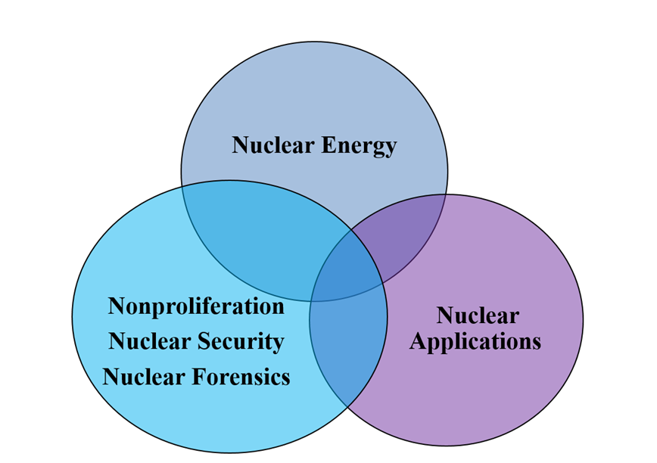
Introduction
The Saudi Nuclear Power Program is a strategic initiative to introduce nuclear energy in the Kingdom's domestic energy mix with local requirements and international commitments.
The Low Power Research Reactor (LPRR) is a 30 KW reactor with uranium dioxide ceramic fuel and is purposed to support the pipeline of human capabilities required for sustainability of the Saudi Nuclear Program.

Slide 3

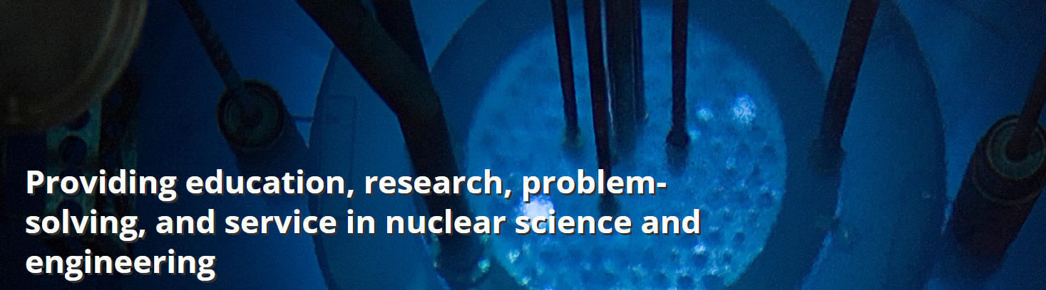
Goal of the IAEA Fellowship
Typical novice training in nuclear science and engineering for research reactors is specific to a one or a few technical areas.
We report on a unique 4-month experience of four IAEA fellows from Saudi Arabia who undertook a variety of research reactor training exercises at the 1.1 MW TRIGA research reactor at the Nuclear Engineering Teaching Lab at the University of Texas

Slide 4
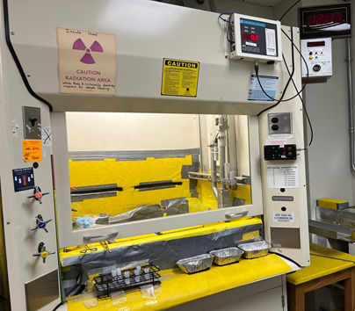
Areas of Training
The main objective of the IAEA fellowship program was to introduce the fellows to the concepts and practice of neutron activation analysis.
The participants followed the successful on-line IAEA course which has been used by many member states.
The practical aspects included using the TRIGA reactor at 30 KW to mimic the power levels of the new research reactor in Saudi Arabia.
Pneumatic Facility

Slide 5
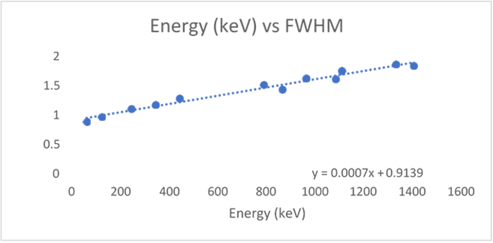
Areas of Training
Gamma Ray Spectrometry: To familiarize the fellows with gamma ray spectrometry a set of simple experiments were performed.
Calibration, resolution and full width half maximum (FWHM).
The relation between energies and FWHM.

Slide 6
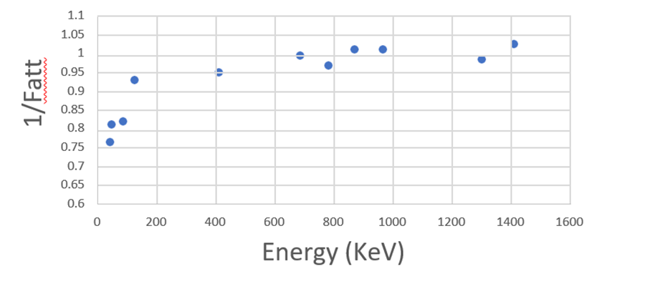
Areas of Training
Gamma ray self-attenuation: In this laboratory, the self-attenuation correction factor for a oil scale sample was determined using a ¹⁵²Eu source.
Determination of environmental gamma radiation background
The laboratory objective was to measure a typical 24-hr background in a room with and without lead shielding.
A good understanding of the decay series of ²³⁸U, ²³⁵U and ²³²Th decay series and ⁴⁰K was achieved by the fellows.
The relation between self-attenuation and gamma ray energy

Slide 7
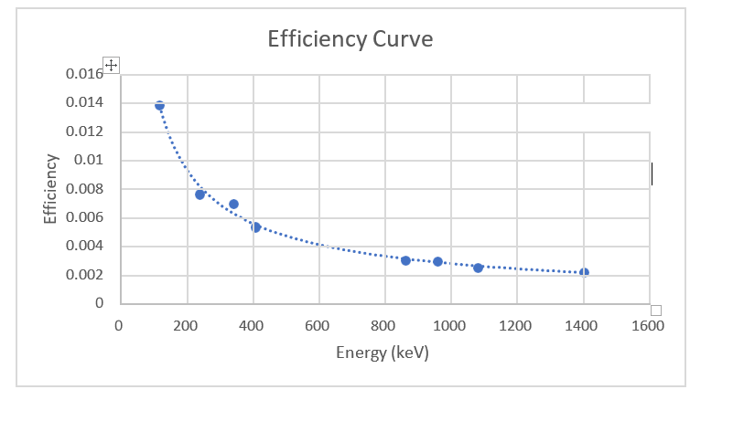
Areas of Training
Determination of uranium fission product/activation activity
1000 μg/g of natural uranium was irradiated for 30 minutes in the TRIGA reactor.
One week later the activity of several fission products and activation of uranium were determined using an efficiency curve constructed with ¹⁵²Eu
Efficiency curve of ¹⁵²Eu 10 cm from the germanium detector

Slide 8
Areas of Training
Control rod worth: The purpose of this experiment was to learn how to measure the reactivity worth of an item in the reactor and to generate an understanding of the impact of control rod worth axial distribution on safe reactor operation.
Fuel rod worth: The purpose of this experiment was to learn how to measure the reactivity worth of a fuel element in the core and to generate an understanding of the impact of its location to the amount of reactivity it adds to the sum of the cores worth.
Operation Training: A 5-day training on reactor operation with a general overview of how a research reactor operates accompanied with some hands-on practice in the form of experiments.
Reactor startup & shutdown: The purpose of this experiment was to study the process of safely starting up and shutting down the reactor. An experience on basic reactor behavior was gained, along with reactor multiplication, knowledge of reactor instrumentation, and observations of subcritical multiplications, also operation modes that are auto, manual, square wave and pulse mode.

Slide 9
Areas of Training
Domestic Licensing: The license Process include construction permit, operating license: fuel loading and operations. Title 10 of the Code of Federal Regulations is one of 50 titles composing the United States Code of Federal Regulations (CFR) and contains the principal set of rules and regulations issued by federal agencies regarding nuclear energy
TRIGA Technical Specifications: The Technical Specifications identify how to operate safely which typically includes a Safety Analysis Report.
Emergency Plans: The emergency response plan criteria include overall responsibilities and on-site response coordination.

Slide 10
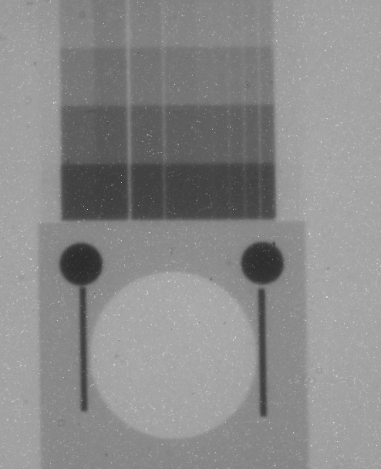
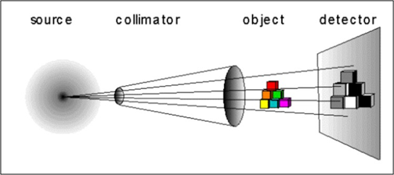
Areas of Training
Neutron Radiography: The neutron radiography system is located at beam port five of the TRIGA reactor.
The beam port five is tangential to the reactor and it provides a high intensity, fast, collimated beam of neutrons
Image Sensitivity Indicator – evaluates minimum detectable flaw size

Slide 11
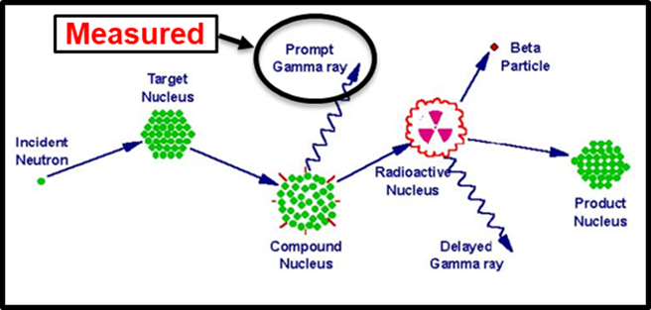
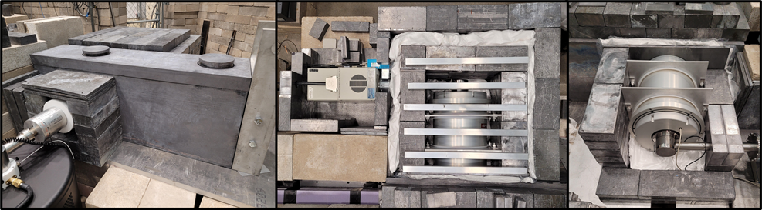
Areas of Training
Prompt Gamma Activation Analysis (PGAA) expands the range of measurement of elemental concentration in samples to some elements that cannot be analyzed using decay gammas.
PGAA is based on the detection of γ-rays emitted after radiative neutron capture reactions and leaves compound nucleus in an excited state.
Several experiments were performed including determining hydrogen concentrations in uranium alloys and carbon fibers.

Slide 12
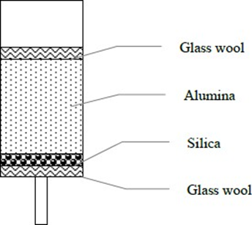
Areas of Training
Radioisotopes Production: The production and separation of ^{99m}Tc through the ⁹⁸Mo(n,γ)⁹⁹Mo (t_{1/2}= 66 hr) →^{99m}Tc(t_{1/2}= 6.6 hr) reaction was performed by irradiation molybdenum in the TRIGA research reactor.
Separation of ^{99m}Tc from ⁹⁹Mo was achieved using the standard glass wool, alumina and silica configuration
Separation column

Slide 13
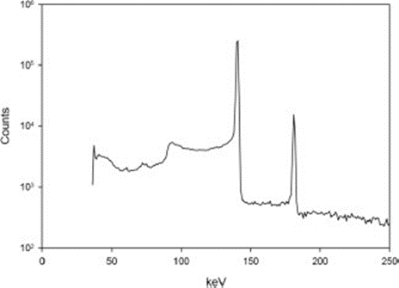
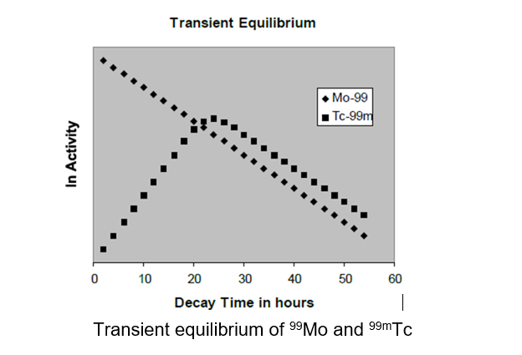
Areas of Training
Gamma ray spectrum of
^{99m} Tc/⁹⁹Mo standard at
140 keV and 180 keV photopeaks, respectively.

Slide 14
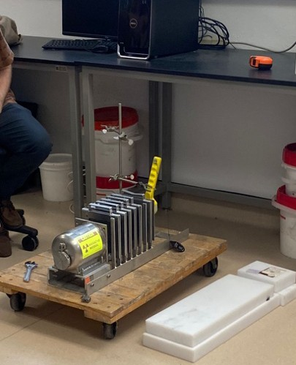
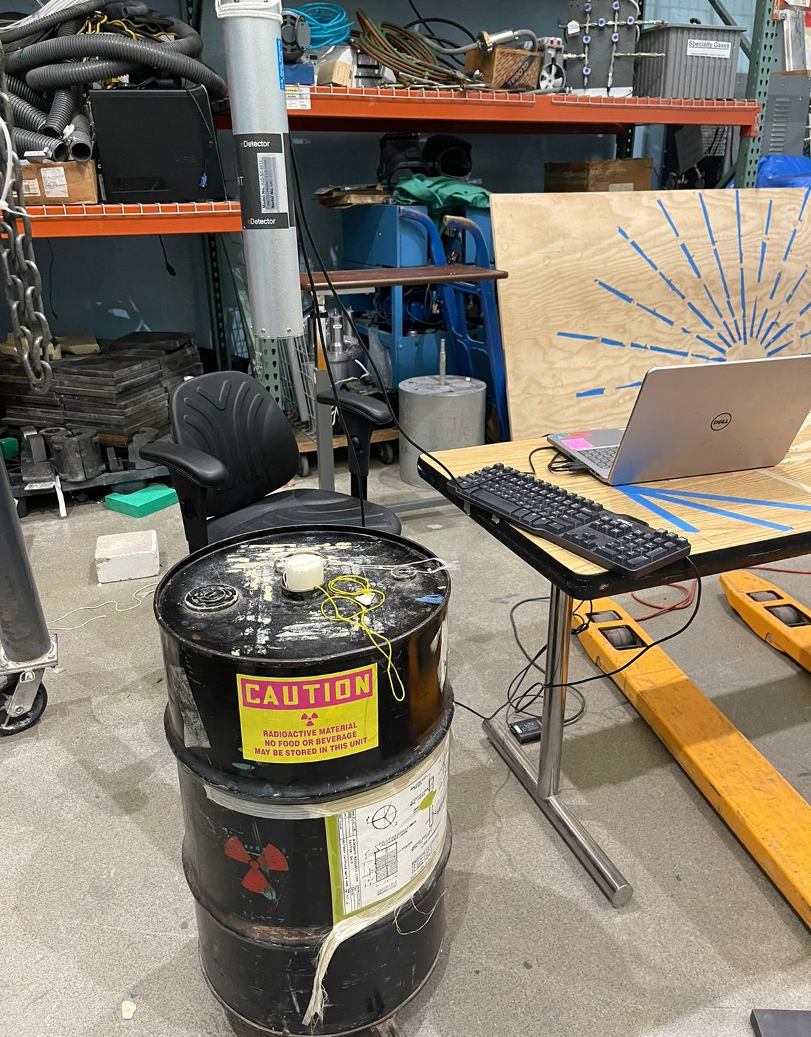
Areas of Training
Nuclear Instrumentation laboratories: To enhance the experience in nuclear instrumentation several additional laboratories were conducted
Neutron shielding
Gamma ray shielding
Gamma-ray spectrometry with a sodium iodide detector
Radiation counting statistics
Personnel monitoring devices and radiation survey instruments

Slide 15
Lectures
All the fellows followed the IAEA E-learning course but addition lectures were given in gamma ray spectrometry including basics of radioactive decay and the origin of gamma and x–ray radiation, the interaction of gamma radiation with matter, detectors, and electronics, counting statistics, quality control and quality assurance.
Specific lectures on applications of NAA included: The determination of uranium in food samples by Compton suppression epithermal neutron activation analysis; Trace elements in eleven fruits widely consumed in the USA as determined by NAA; Radiation protection for NAA; Determination of soil depth profiles for ¹³⁷Cs and ²¹⁰Pb using gamma ray spectrometry with Compton suppression; Evaluation of atmospheric airborne particles in Lisbon, Portugal using NAA;

Slide 16
Lectures
Fully automated fast pneumatic system for NAA; Different modes of NAA for air pollution studies in the Finnish Arctic aerosol; An evaluation of Compton suppression NAA for determination of trace elements in geological samples; Determination of bromine, chlorine and iodine in environmental aqueous samples by epithermal NAA and Compton suppression; Update of uranium fission interference in NAA; Investigation of bauxite residue (red mud) in terms of its environmental risk; Assessment of industrial diamonds for Co, Cr, Fe, Mn, Ni, and Si using thermal and epithermal neutron activation analysis with Compton suppression; Determination of silver using cyclic epithermal NAA;

Slide 17
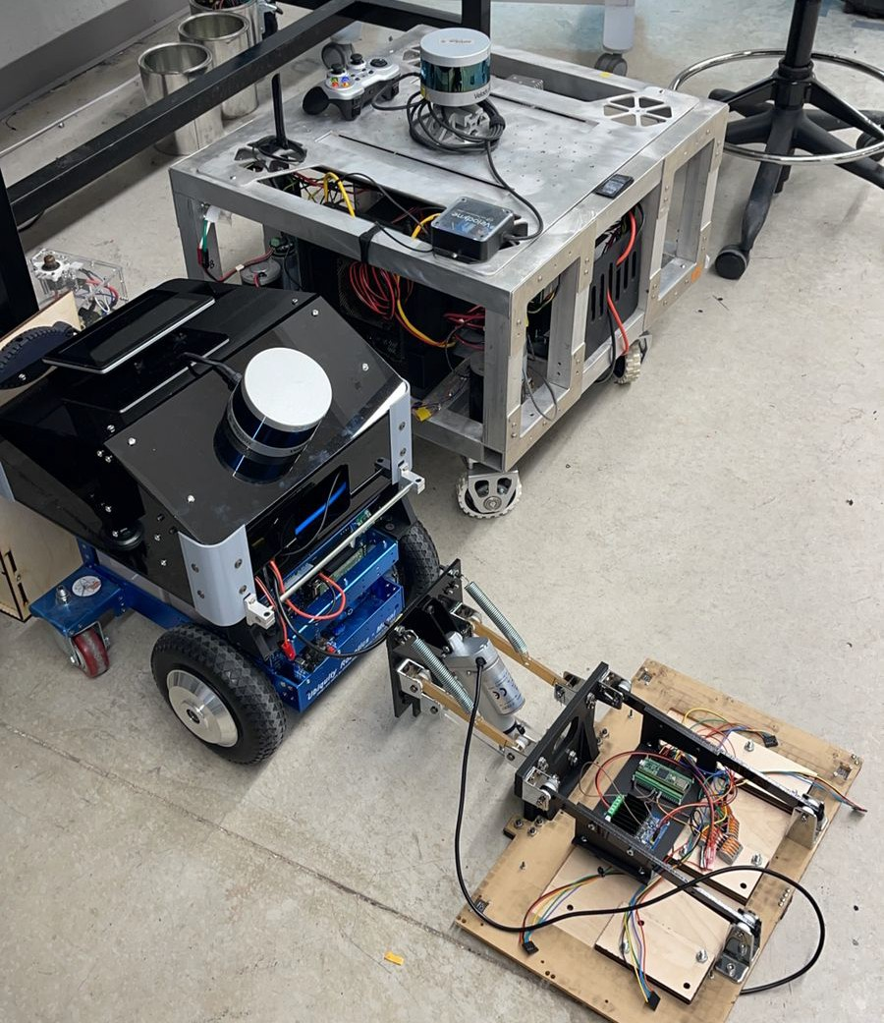
Site Visit
The Nuclear and Applied Robotics Group (NRG) at the University of Texas at Austin has developed capabilities for autonomous surveying of beta/gamma radiation fields to address each of these issues.

Slide 18
Group Project
Neutron activation analysis of galena rock and oil scale samples
All analyses were done in EXCEL and not automated analysis
Sample preparation
Irradiation request form
Safety handling of irradiated samples
Quality assurance
Quality control
Uncertainty propagation
Detection limits

Slide 19
Conclusions
The experience of the four fellows from Saudi Arabia to a wide range of research reactor topics and supporting nuclear instrumentation greatly enhanced their understanding of the breadth of applications.
The additional training in reactor operations and regulatory aspects also increased their knowledge of the needed workings to provide safe usage of reactors.
This unique training may be an ideal template for those workers in current and future research reactors as well as for academic graduate courses.

Slide 20
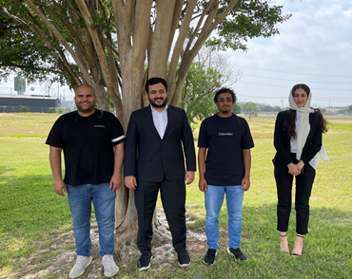
Acknowledgements
We would to thank the IAEA for its support for the four fellows from Saudi Arabia for the four-month fellowship.
We also thank the staff of the Nuclear Engineering Teaching Lab for their support in training and reactor operations.
“The training will impact our professional career profoundly”

